Slide 1
The current status and future of HIV D+/R+ heart and lung transplantation
Vagish Hemmige
Professor, Albert Einstein College of Medicine
Staff Physician, Division of Infectious Diseases, Montefiore Medical Center
2025-10-9

Slide 2
Disclosures
Research funding from Merck to study pneumococcal vaccine response in LVAD recipients

Slide 3
Overview
Overview of end stage organ disease and transplantation in people with HIV
HIV D-/R+ heart transplantation
HIV D-/R+ lung transplantation
Overview of HIV D+/R+ transplantation
HIV D+/R+ heart transplantation
HIV D+/R+ lung transplantation

Slide 4
Objectives
Review outcomes to date in thoracic transplants with HIV from donors with and without HIV
Discussed the "nuts-and-bolts" steps of implementing a HIV D+/R+ transplant program, from approvals to establishing a protocol
Identify potential barriers to HIV D+/R+ thoracic transplantation

Slide 5
OVERVIEW OF HIV D-/R+ TRANSPLANT

Slide 6
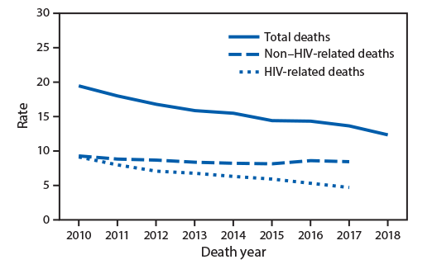
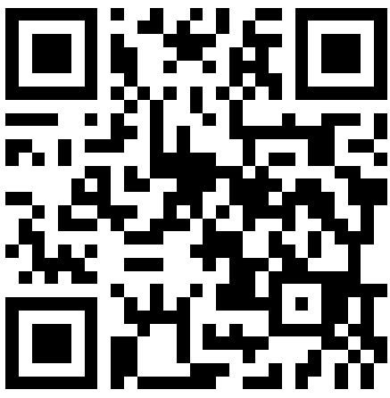
Introduction
Antiretrovirals have transformed HIV into a chronic disease
In the modern era, the majority of people living with HIV die from non-HIV comorbidities
MMWR Morb Mortal Wkly Rep 2020;69:1717–1724.

Slide 7
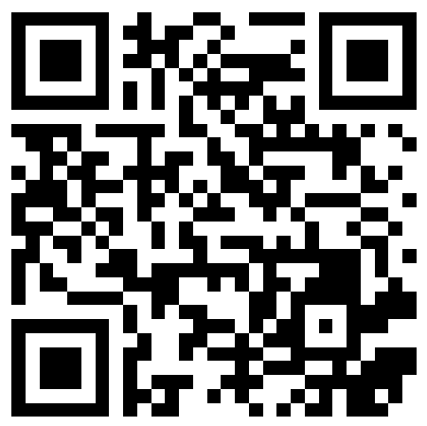
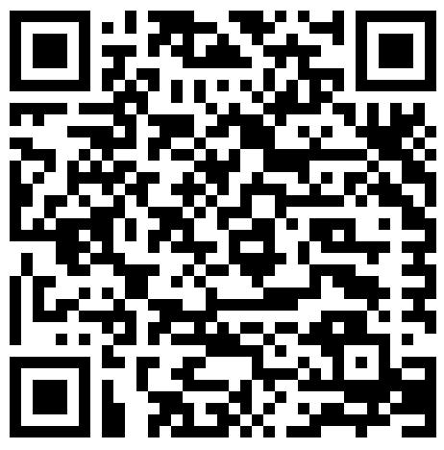
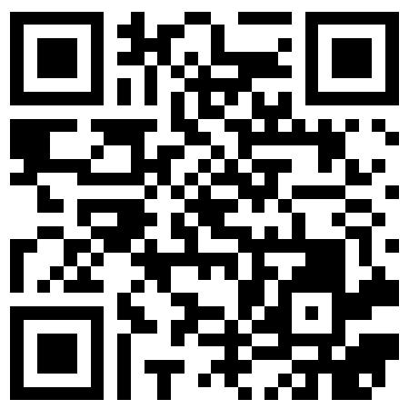
HIV is a risk factor for end-organ disease
Direct effects of HIV
Older antiretrovirals (TDF)
Liver disease
Hepatitis B/C
Alcohol
Cardiac disease
Inflammation→increased risk of myocardial infarction
Smoking
Older antiretrovirals
Abacavir
Direct effects of HIV
Lung disease
HIV-associated pulmonary hypertension
Smoking
Prior infection (pneumocystis)
Independent effect of HIV?
Kidney disease
900 new dialysis patients/year
~15% of deaths in people with HIV
~2400 people with HIV with advanced heart failure
Unknown
J Heart Lung Transplant. 2014 Sep;33(9):924-30.
Clin J Am Soc Nephrol. 2017 Mar 7; 12(3): 467–475.
Arch Intern Med. 2006 Aug;166(15):1632-41.

Slide 8
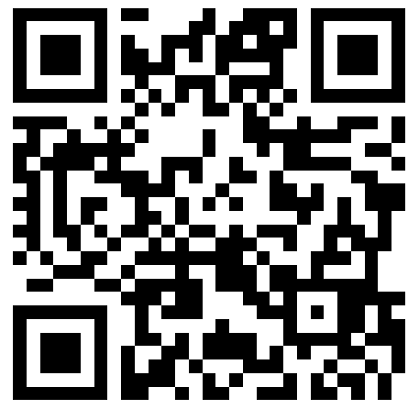
HIV and end-organ disease
People with HIV are more likely to die once they develop end organ disease
They are less likely to be:
  Referred to a transplant center by their providers
  Listed for transplant once referred
  Transplanted once listed
Clin J Am Soc Nephrol. 2017 Mar 7;12(3):467-475.

Slide 9
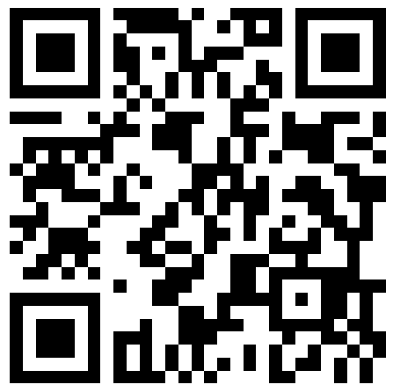
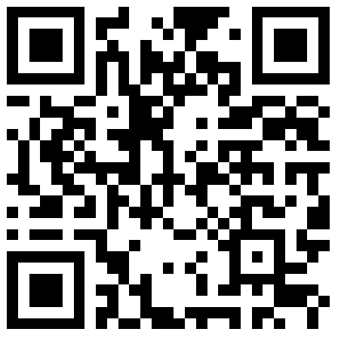
Early experience with HIV and transplant
Studies in the early 2000s demonstrated that people living with HIV with suppressed viral loads could safely receive kidney and liver transplants under select conditions:
  CD4 count 200+ cells/μL for kidney, 100+ cells/μL for liver
  Viral load under 75 copies/mL (except for “blips”). Note: this requirement can be waived under appropriate circumstances.
  No history of opportunistic infection for which prophylaxis does not exist (e.g. PML)
Transplantation. 2003 Jul 27;76(2):370-5.
N Engl J Med. 2010 Nov 18; 363(21): 2004–2014.

Slide 10
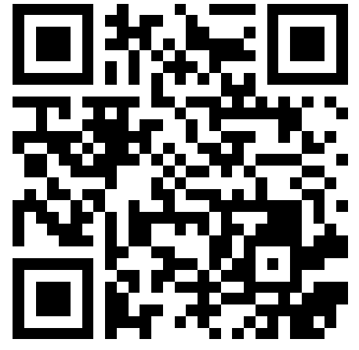
Early experience with HIV and transplant
Early challenges
Ritonavir and cobicistat interact strongly with transplant medications
Providers did not provide enough immunosuppression, leading to rejection and transplanted organ failure
Changes in management
Use of modern integrase inhibitors to avoid boosting agents
Patients with HIV and hepatitis C demonstrated poorer survival after transplant
More comfort with immunosuppression
Better treatment for hepatitis C
Clin Microbiol Rev. 2024 Mar 14;37(1):e0011122.

Slide 11
Evaluation of the pre-transplant PLWH for transplant candidacy
Patient should be on a stable regimen. Note: patients have undergone liver transplant with this requirement waived due to the predicted ability to obtain viral suppression post-transplant
Traditionally, CD4+ lymphocyte count should be over 200 cells/μL.
  Acute illness can suppress CD4+ lymphocyte count, and measurements taken in the setting of acute illness should be evaluated with caution.
  Some centers have waived this requirement
Viral suppression prior to transplant
  Modern assays can quantify viral loads as low as 20 copies/mL, but a viral load in the 20-50 range is of no consequence for transplant if the patient is adherent
  Patients may experience non-sequential transient “viral blips” in the 50-200 range; the test merely needs to be repeated
HIV/ID specialist should review regimen. Integrase regimen preferred to avoid drug interactions
Previous opportunistic infection is not necessarily a contraindication, but should prompt an evaluation of the need to revise the post-transplant prophylaxis strategy
Clin Microbiol Rev. 2024 Mar 14;37(1):e0011122.

Slide 12
Contraindications
Active opportunistic infection
History of CNS process such as PML, lymphoma
Visceral Kaposi’s Sarcoma or active malignancy (exception anal/cervical dysplasia)
Inadequately treated fungal or mycobacterial process
Multidrug resistant virus is less of an issue given newer and more potent agents
Clin Microbiol Rev. 2024 Mar 14;37(1):e0011122.

Slide 13
Evaluating the pre-transplant opportunistic infection history
Infection History | Comments
Pneumocystis jirovecii | No active disease Evidence of immune reconstitution
Candidiasis, esophageal or oral | No active disease Evidence of immune reconstitution
Herpes Simplex infection | No active disease Easy suppression with antivirals
Mycobacterial disease (tuberculosis, MAC) | Patients must have completed treatment prior to transplant evaluation No evidence of disease
Cutaneous Kaposi sarcoma | No evidence of disease Evidence of resolution following immune reconstitution

Slide 14

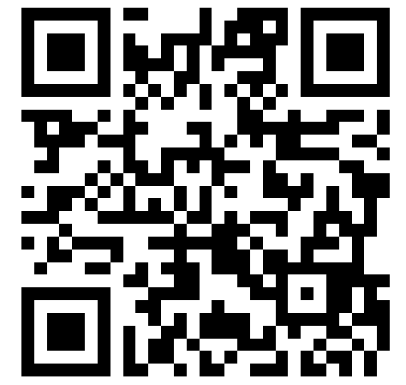
Post-transplant management
Prophylactic and other management strategies typically the same regardless of HIV status unless history of OI
  PJP prophylaxis a traditional exception
Data from kidney suggest better outcomes in PLWH who receive lymphocyte depleting therapy as induction
Lessons from kidney and liver emphasize the importance of close teamwork:
  Transplant team
  Transplant ID
  HIV specialists if Transplant ID lacks familiarity with modern antiretroviral regimens
  Pharmacy
Am J Transplant. 2016 Aug;16(8):2368-76.

Slide 15
Customizing prophylaxis
Opportunistic Infection | Prophylaxis
Pneumocystis | TMP/SMX Alternates: atovaquone, dapsone
CMV | Valganciclovir
History of cryptococcus Successful treatment With immune reconstitution | Fluconazole
Mycobacterium avium complex with successful treatment and immune reconstitution | Azithromycin
Toxoplasmosis | TMP/SMX

Slide 16
HIV D-/R+ HEART TRANSPLANT

Slide 17
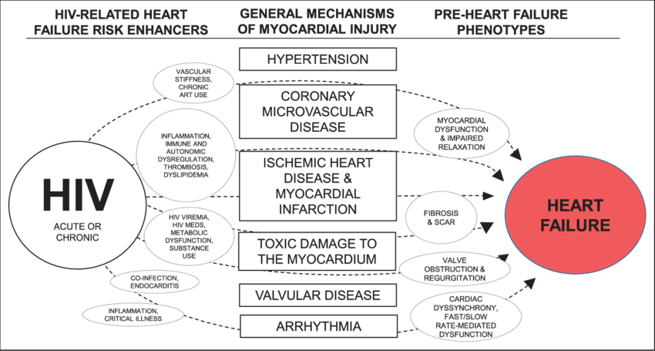
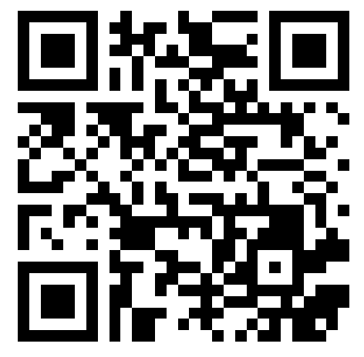
HIV doubles the risk of advanced heart failure
Circulation. 2019 Jul 9;140(2):e98-e124.

Slide 18
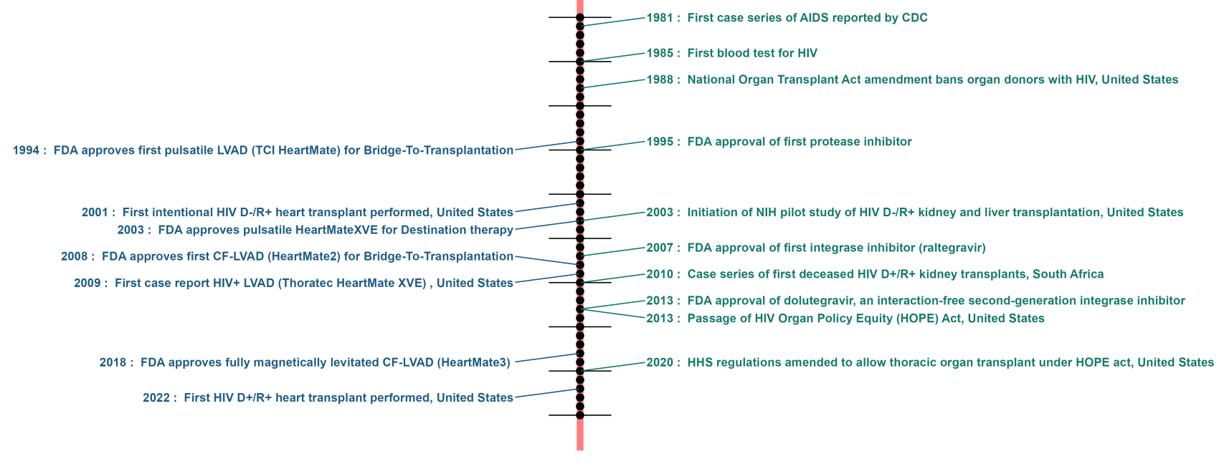
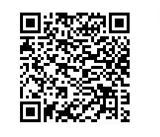
Progress in advanced heart failure care for PLWH has tracked general advances in HIV care
J Heart Lung Transplant. 2023 Sep;42(9):1194-1196.

Slide 19

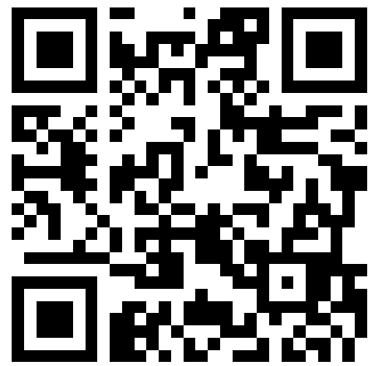
ISHLT guidelines have evolved to support heart transplant in PLWH
Pre-2014: HIV considered an absolute contraindication
2014-2024: HIV considered a relative contraindication
2024-present: Well-controlled HIV no longer an impediment to cardiac transplantation
J Heart Lung Transplant. 2024 Oct;43(10):1529-1628.e54.

Slide 20
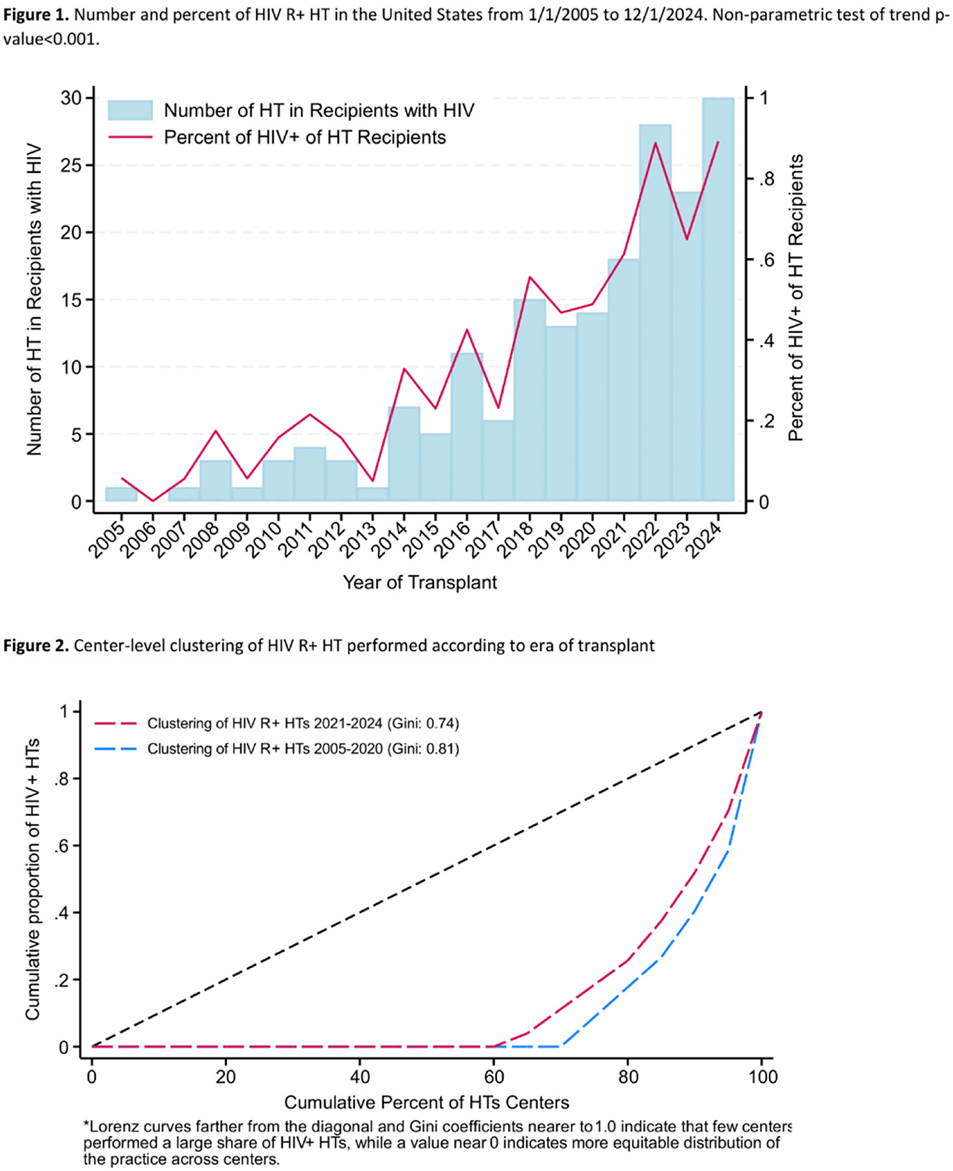
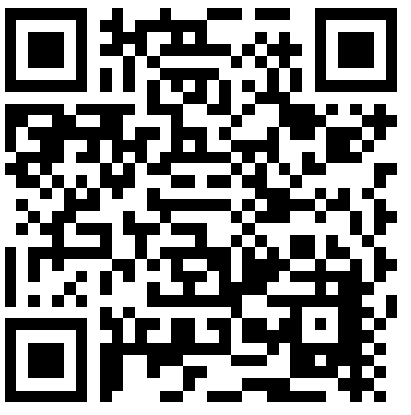
More centers willing to offer heart transplant to PLWH
187 HIV D-/R+ heart transplants to date performed in US as of 2024, including 2 heart-lung recipients
  Half of transplants performed at 16 centers; most have performed none
  The UNOS database reached this number of D-/R+ kidney and liver transplants over 15 years ago
  Currently 30+ transplants/year
WTC 2025.

Slide 21
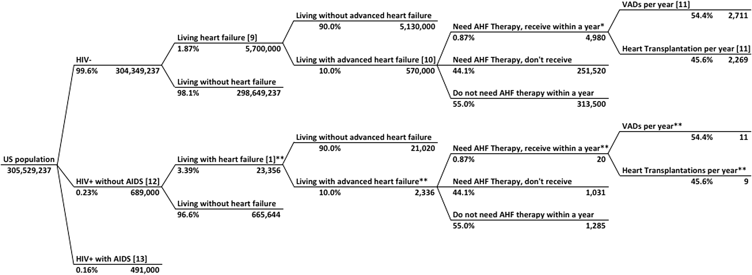
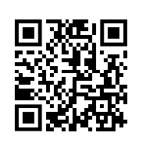
Does the current rate and pattern of transplant in the United States meet the need?
J Heart Lung Transplant. 2014 Sep;33(9):924-30.

Slide 22
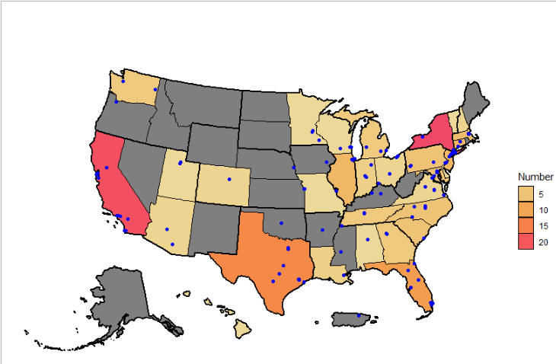
Does the current rate and pattern of transplant meet the need?
Unpublished.

Slide 23
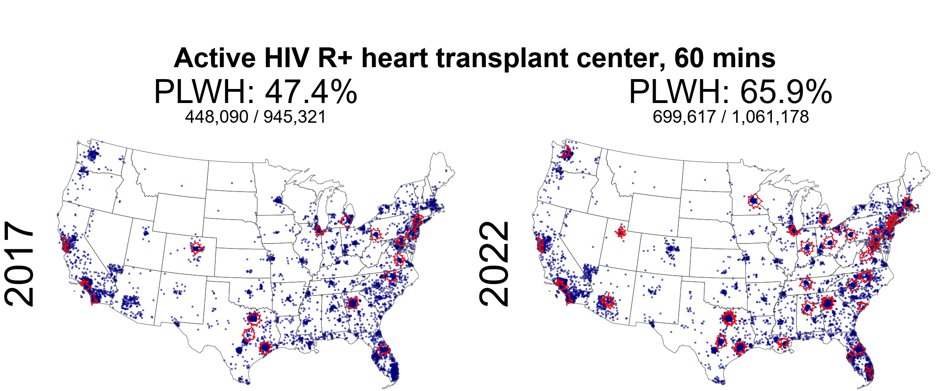
Improving access to heart transplant centers willing to offer transplant
Unpublished.

Slide 24
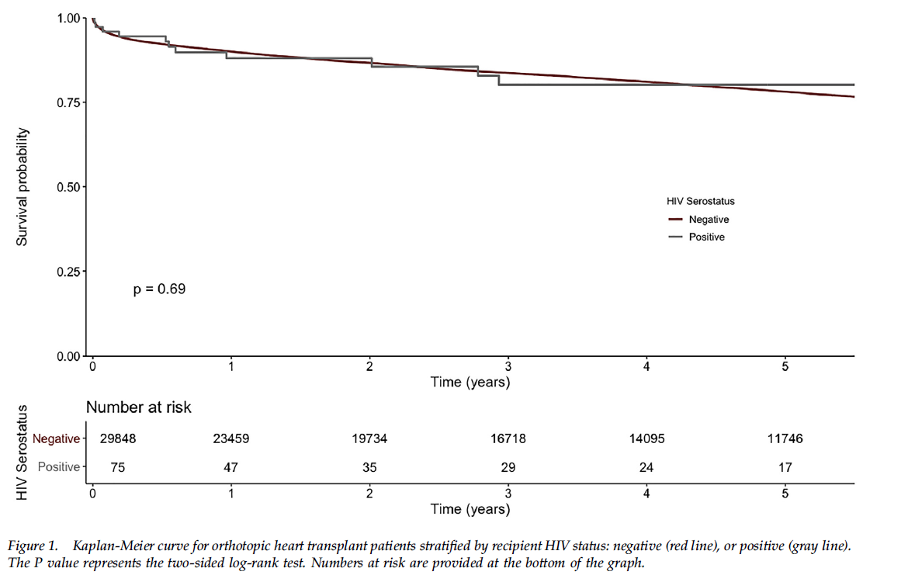

HIV D-/R+ heart outcomes in the United States
No difference
  Survival
  Malignancy
  Graft vasculopathy
  Acute rejection prior to primary discharge (38.7% versus 17.7%)
  Antirejection treatment administration (26.7% versus 10.4%)
Higher rates in PLWH
Ann Thorac Surg. 2021 May;111(5):1465-1471.

Slide 25

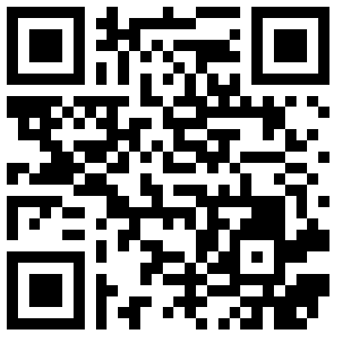
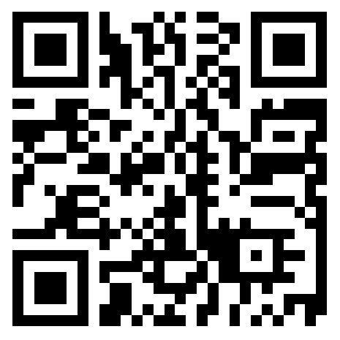
Experience outside of the United States limited to case reports or case series
Koval et al included international cases in a seminal series of 21 cases
Other individual case reports from Taiwan and Europe
  Acceptable survival rates
  High rates of rejection (>60%)
J Heart Lung Transplant. 2019 Dec;38(12):1296-1305.
J Microbiol Immunol Infect. 2022 Oct;55(5):982-984.

Slide 26
HIV D-/R+ LUNG TRANSPLANT

Slide 27
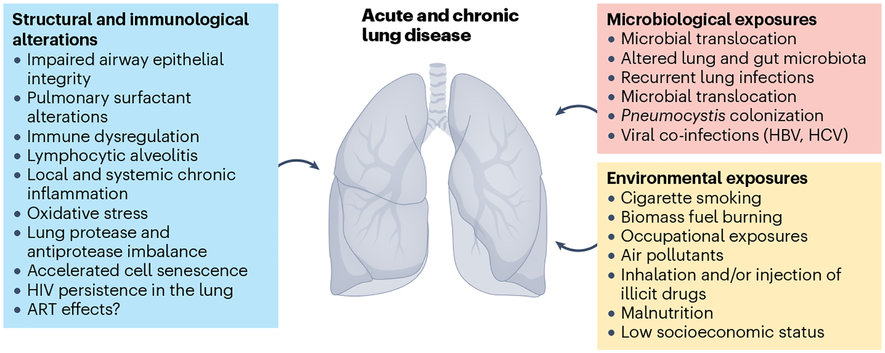
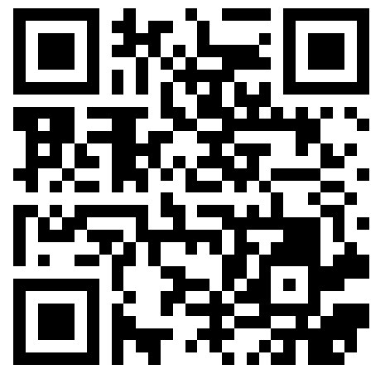
HIV is a risk factor for end-stage lung disease
Nat Rev Dis Primers. 2023 Jul 27;9(1):39.

Slide 28

Accelerated COPD development in PLWH who smoke
Younger age
Lower pack-year history
CHEST 2006; 130:1326 –1333.

Slide 29
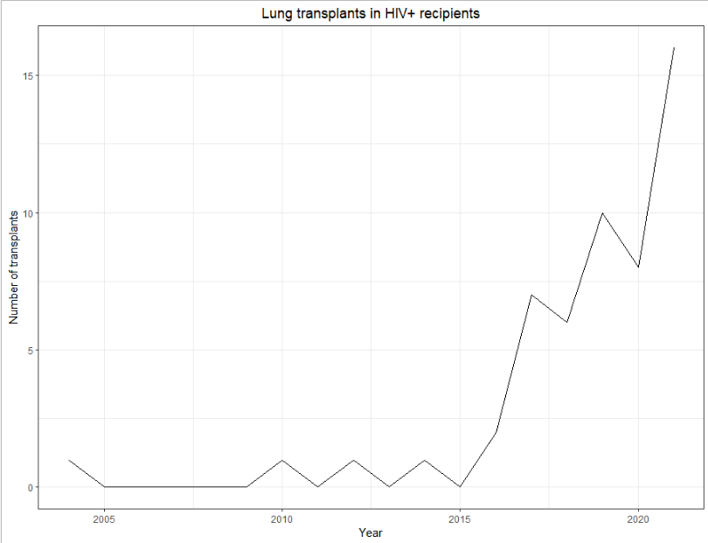
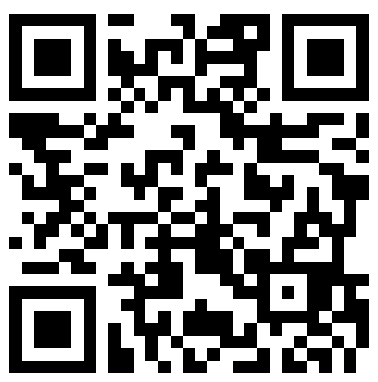
Increasing numbers of HIV D-/R+ lung transplant
As of 2024, 96 HIV D-/R+ lung transplants to date performed in US as per the SRTR, including the two aforementioned heart-lung transplants
  The UNOS database reached this number of D-/R+ kidney transplants 20 years ago
Well over half performed since 2019
Four centers responsible for 50+% of transplants
Recipient selection criteria an open question
Transpl Infect Dis. 2025 Aug 8:e70090.

Slide 30
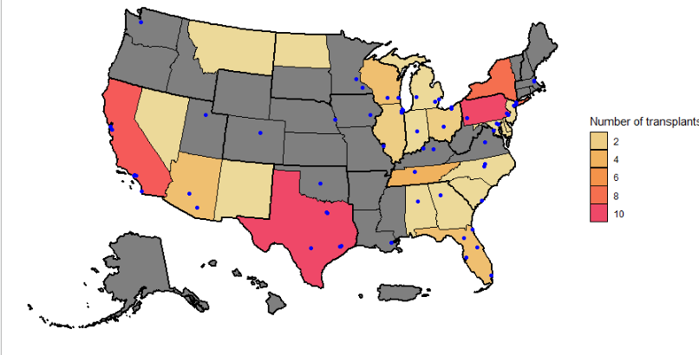
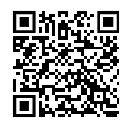
The geography of HIV D-/R+ lung transplant in the US
ATC 2023, abstract 279

Slide 31
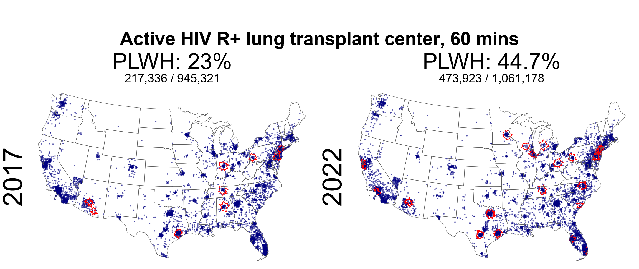
Increasing access to lung transplant for PLWH, 2017-2022
Unpublished.

Slide 32
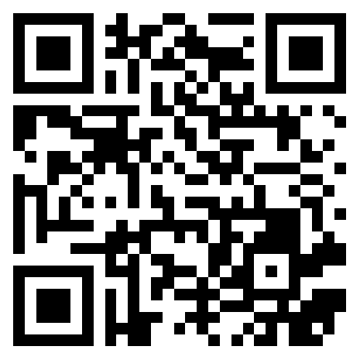
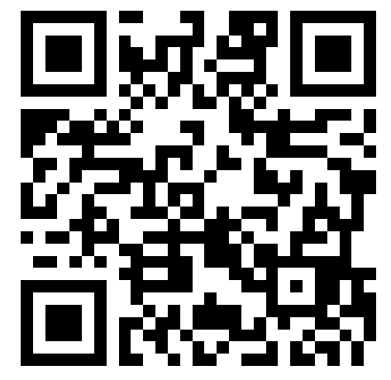
Equivalent survival in lung transplant recipients with HIV
Transplantation 2024. Apr 1;108(4):1015-1020
Clin Transplant 2024 Jan;38(1):e15246.

Slide 33
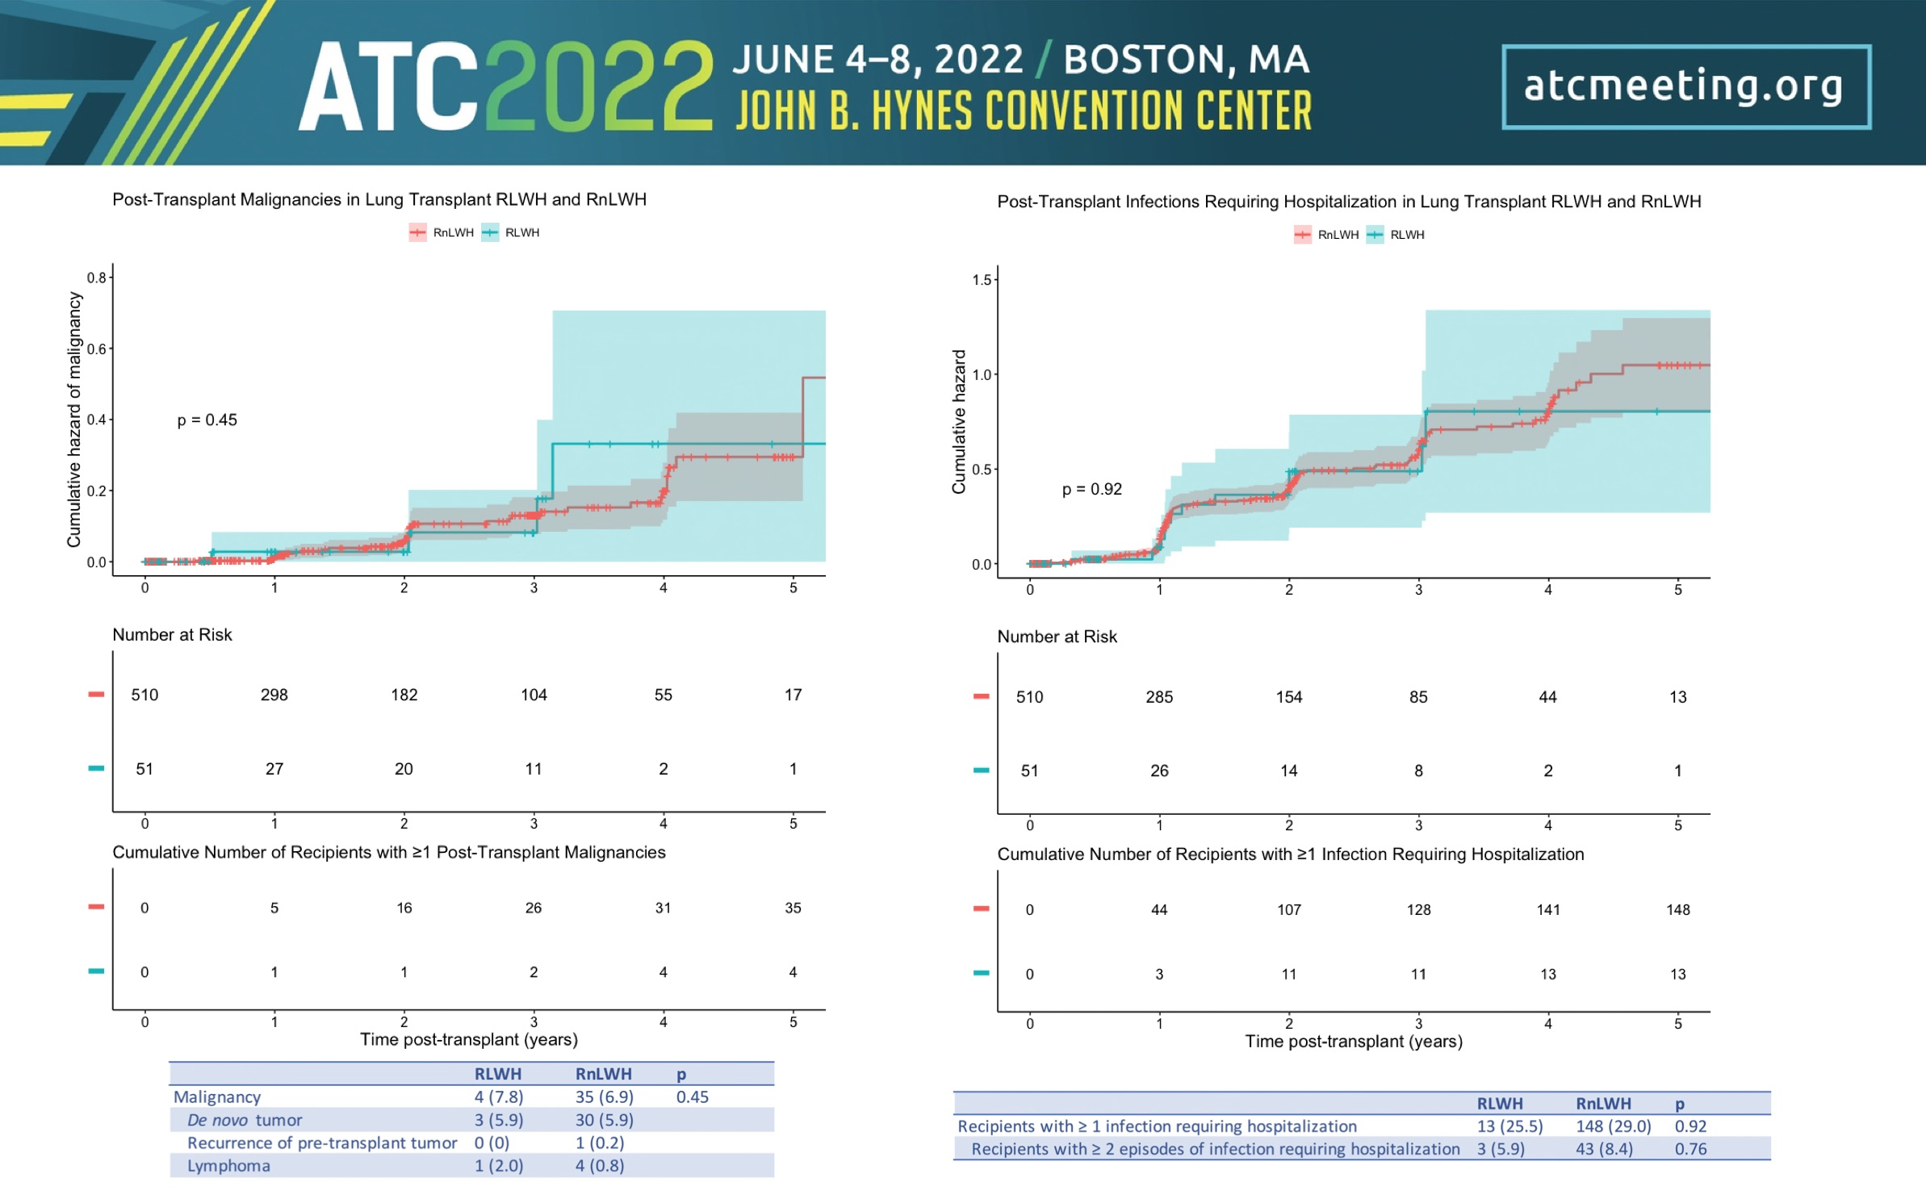
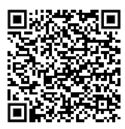
Equivalent malignancy rate and infection hospitalization rates in lung tx recipients with HIV
ATC 2022, abstract 357

Slide 34
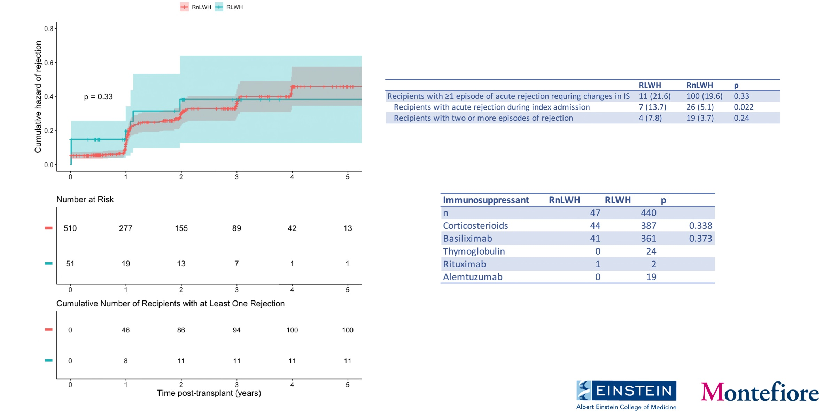
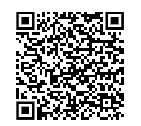
Increased rejection during the initial hospitalization in lung transplant recipients with HIV
ATC 2022, abstract 357

Slide 35
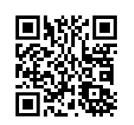
Similar outcomes in European experience (case series without control)
Eur Respir J. 2022 Jul 13;60(1):2200189.

Slide 36
Increasing the donor supply
More patients eligible for transplant
Fixed supply organ
?

Slide 37
OVERVIEW OF HIV D+/R+ TRANSPLANT

Slide 38
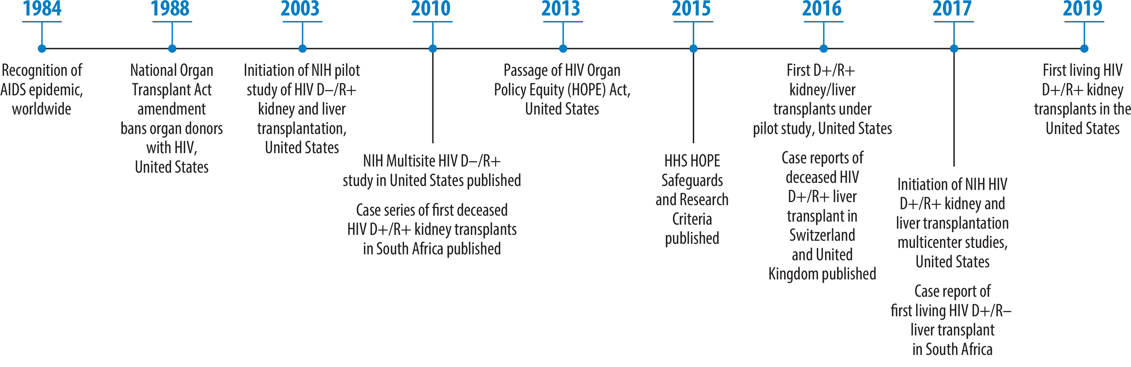
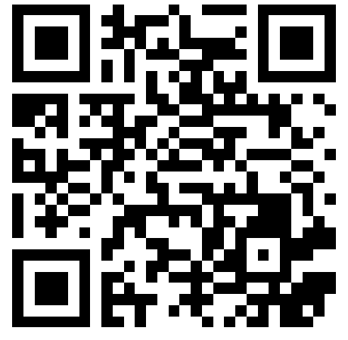
Federal law
Transplantation of organs from donors who test positive for HIV was banned by the National Organ Transplant Amendments (NOTA) Act of 1988, which reflected the poor outcomes of transplant-associated HIV in an era without effective treatments for HIV
Annu Rev Med. 2021 Jan 27:72:107-118.

Slide 39
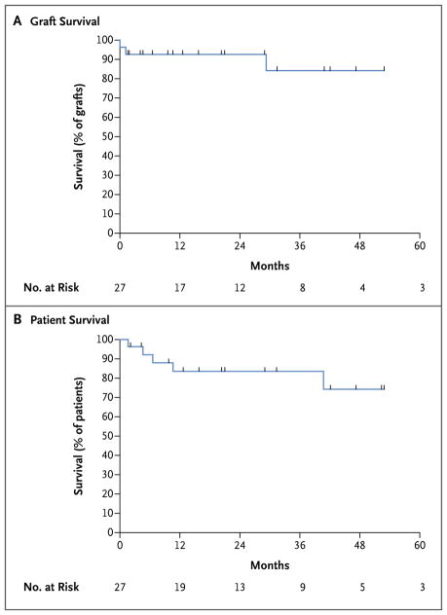
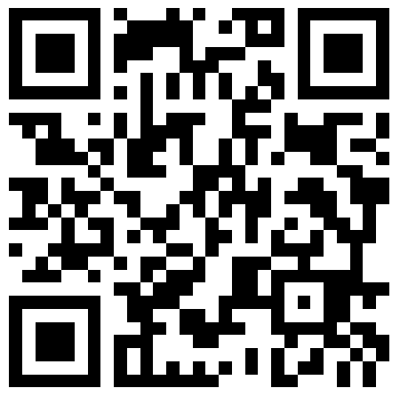
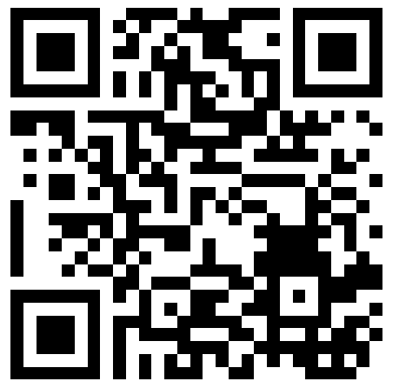
First HIV-to-HIV transplants
The first study of HIV D+/R+ transplant was done in South Africa
  Limited access to dialysis
  High prevalence of HIV
N Engl J Med. 2010 Jun 17; 362(24): 2336–2337.
N Engl J Med. 2015 Feb 12; 372(7): 613–620.

Slide 40
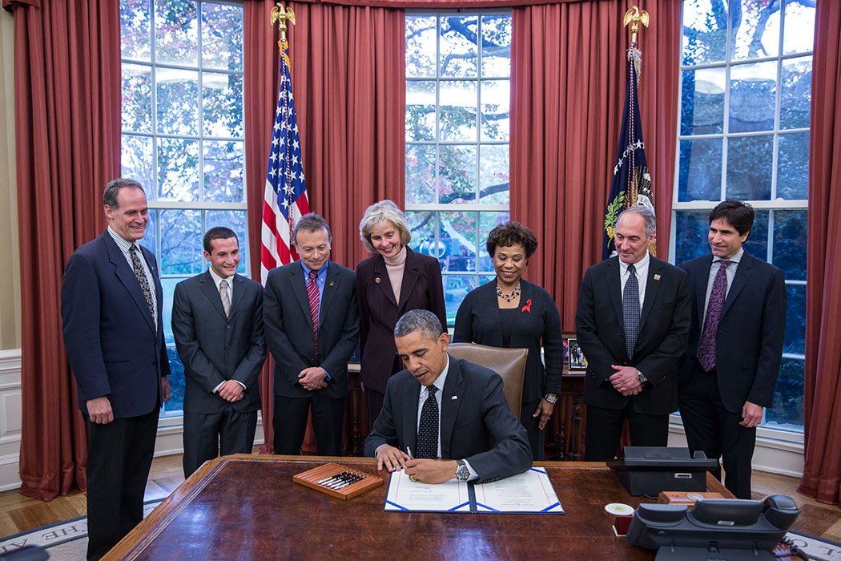
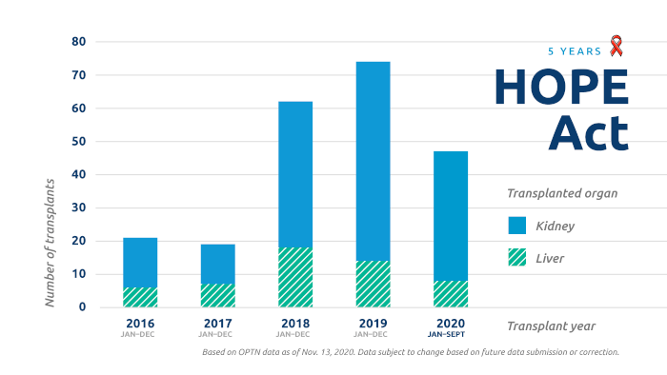
The HIV Organ Policy Equity Act (the HOPE Act)
Federal law signed 21 Nov 2013
Permits transplantation of kidneys and livers from HIV+ donors (D+) into HIV+ recipients (R+) under research protocols
On 7 Jun 2020 amended to include other organs
Program initially required to have organ-specific experience with 5 HIV D-/R+ to perform D+/R+

Slide 41
Why is HIV D+/R+ different? What are the concerns?
Resistance
Infection
Malignancy (especially lymphoma)
Rejection
Of note, only rejection has been an issue in actual practice.

Slide 42
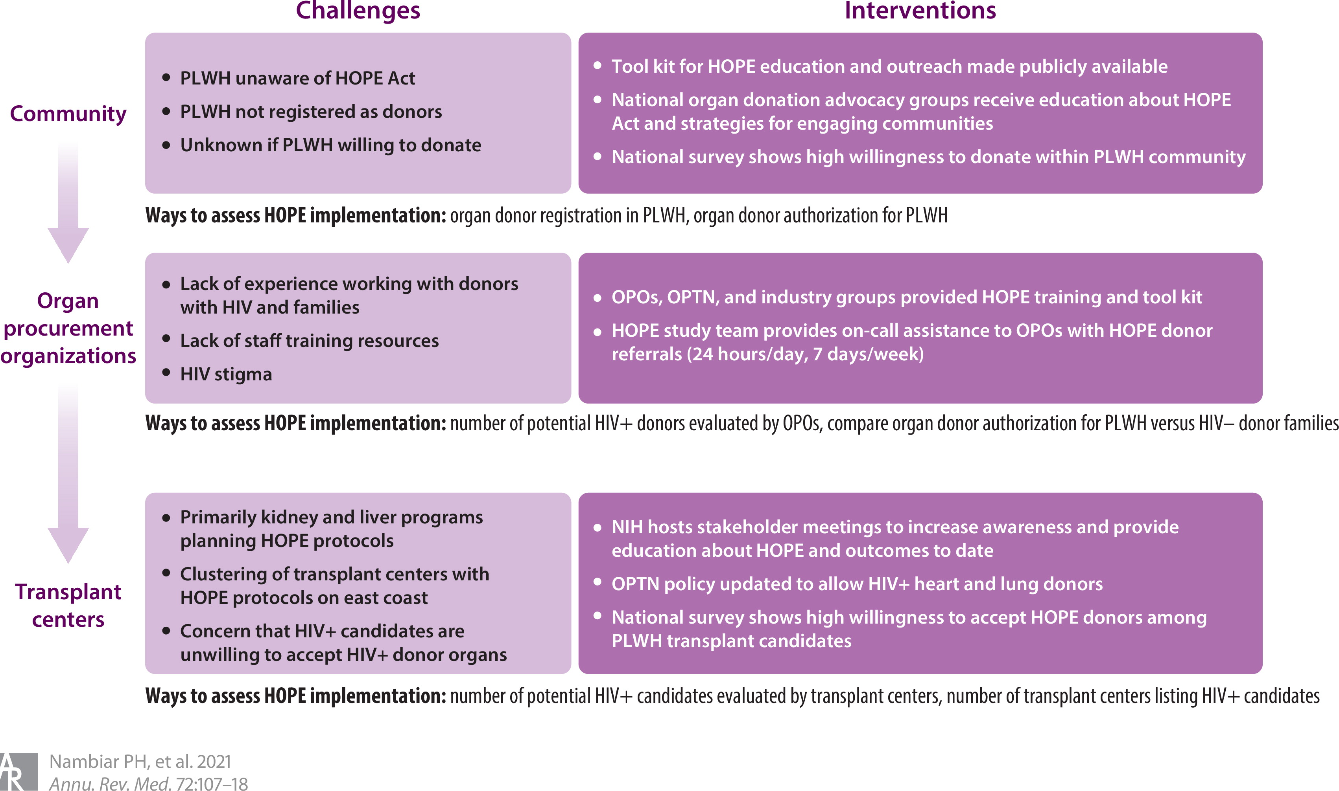
Many barriers exist to HIV D+/R+ transplant

Slide 43
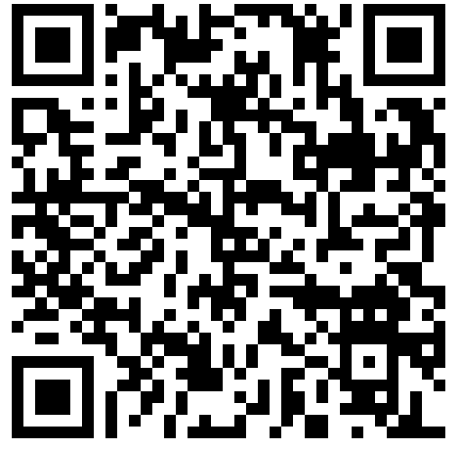
Are patients with HIV willing to accept HIV positive organs?
Most pts willing to accept:
  HIV+ living donor organs (87%)
  HIV+ deceased donor organs (84%)
  Increased infectious risk donor organs (70%)
Thirty percent of patients expressed concerned about HIV superinfection and transmitted resistance, but even a majority (71%) of these pts would accept an HIV offer
Other concerns that led them to decline enrollment:
  HIV D+/R+ transplantation was safe (45% vs. 77%, P = 0.02),
  HIV D+ organs would work similar to HIV D− organs (55% vs. 77%, P = 0.04)
  Would receive an infection other than HIV from an HIV D+ organ (64% vs. 13%, P < 0.01).
J Acquir Immune Defic Syndr. 2020 Sep 1;85(1):88-92.

Slide 44

So, as a practical matter, what needs to happen for an HIV-positive donor?
Organ offer received
ID contacted EARLY IN THE PROCESS
ID to review emails from Hopkins listserve and DonorNet
ID to reach out to Hopkins (either via email or cell phone)
  OPO is supposed to reach out to Hopkins, but frequently this does not happen
Hopkins dedicated HOPE act coordinator can obtain pharmacy records and clinic notes (note, this typically has to happen during waking hours)
Detailed review of all medical records and multidisciplinary discussion leading to decision to accept or reject

Slide 45
What does ID do when we get called about a potential HIV-seropositive donor?
Resistance
Prior HIV genotypes
Treatment history
Opportunistic infection
CD4+ count
Viral load
Malignancy
Medical records
Medical records

Slide 46
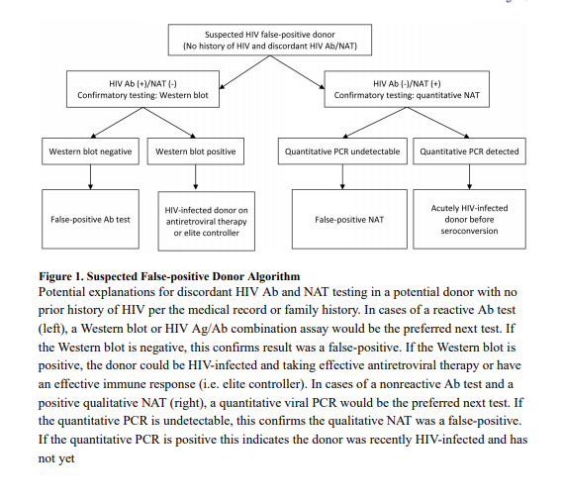
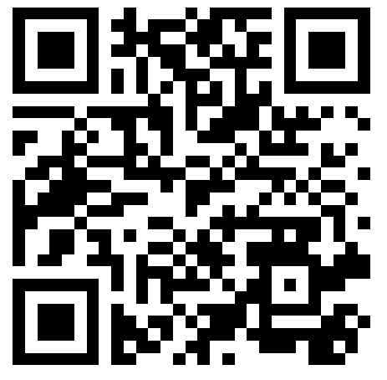
False positive HIV tests
Typically, organs from potential donors with suspected false positive HIV testing were discarded, but the HOPE act means that these organs can now be used.
These donors have reflected ~1/3 of organs transplanted under the HOPE Act.
Am J Transplant. 2018 Oct;18(10):2579-2586.

Slide 47
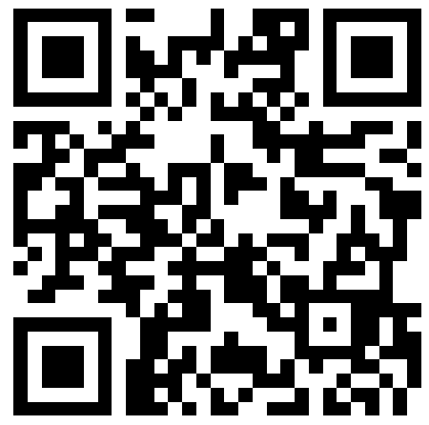
Can we take donors without knowing their full history?
Donors with HIV are frequently undiagnosed and not on medications
This is fine! Outcomes when the donors are carefully evaluated have been acceptable with no transmissions of any infection or resistant virus
Am J Transplant. 2021 May;21(5):1754-1764.

Slide 48
Nuts and bolts of the HOPE evaluation process
  No published guidelines as to what is or is not an acceptable donor.
  Much of this area is a completely evidence-free zone, so we frequently find ourselves hitting the “phone a friend” button
    Internal group chat
    Email with HOPE leadership
  Substantial center to center variation in acceptance criteria and in process

Slide 49

Nuts and bolts of the HOPE evaluation process
Barrier | Intervention
Concerns about resistant HIV in the donor | Presented data from HOPE trial and nationally about lack of resistance in donors without prior treatment history. Education regarding novel antiretrovirals and their outcomes in patients with drug resistant HIV
Lack of HIV-specific expertise among all transplant ID faculty | All transplant ID faculty joined the HOPE act email list. Designated transplant ID faculty who continued to provide HIV primary care as champions to be contacted with HIV-specific questions for each offer
Lack of colleague support for off-hours difficult cases. Fear of being the first to accept an offer in case of a less than positive outcome | Involvement of senior leadership in the multidisciplinary meetings to ensure that all clinicians felt comfortable with what senior leadership considered an acceptable offer. Practice at the meetings at “getting to yes”
Lack of continuity among accepting physician teams (no learning between cases) | Discussion of every organ offer at the monthly meeting to ensure that all providers could learn from each offer
Initial and downstream organ quality concerns, such as rejection risk | A research team member from the lead center of the NIH-funded multicenter HOPE study shared outcomes data with our group
  Substantial improvement in HOPE acceptance rates with a standardized approach including monthly case discussions
Transpl Infect Dis. 2025 Apr 20:e70039.

Slide 50



Outcomes in kidney transplant patients under the HOPE Act
N Engl J Med 2024;391:1390-1401.

Slide 51

Outcomes in kidney transplant patients under the HOPE Act
N Engl J Med 2024;391:1390-1401.

Slide 52


Wait times in kidney transplant patients under the HOPE Act
Transplantation. 2023 Nov 28;108(3):759–767.

Slide 53

Wait times in kidney transplant patients under the HOPE Act
Transplantation. 2023 Nov 28;108(3):759–767.

Slide 54


Outcomes in liver transplant patients under the HOPE Act
At time of last analysis, 24 HIV D+/R+ transplants done to date
Survival numbers acceptable but liver may have more infections and cancer, which needs to be balanced against risk of dying on liver transplant list
Am J Transplant. 2022 Mar;22(3):853-864.

Slide 55
HOPE Act
Despite the successes, volumes to date have been less than anticipated
500-600 transplants/year
Anticipated volume:
Actual volume:
Am J Transplant. 2011 Jun; 11(6): 1209–1217.

Slide 56

Referral patterns
There is no organized system to funnel patients with HIV and advanced organ failure to centers experienced with their care
It’s up to patients (and their providers) to navigate the system, find an appropriate transplant center, and navigate the transplant cascade of care

Slide 57


Changing legal requirements in the United States will improve access to HIV D+ transplantation
United States:
  Kidney and liver transplant: standard of care
  Thoracic transplant: volume requirements replaced with proof of multidisciplinary expertise
    Medicine
    Surgery
    HIV/Transplant
    Pharmacy
Canada: “exceptional distribution” requirements
Australia: First HIV D+/R+ transplant 2021 (kidney).
https://journals.lww.com/transplantjournal/toc/2023/10001

Slide 58
HIV D+/R+ HEART TRANSPLANT

Slide 59


HIV D+ donors: what are non-rejection concerns for heart?
Systolic dysfunction/HFrEF
Diastolic dysfunction/HFpEF
Premature coronary artery disease
  Cumulative viremia
  Nadir CD4 count
  Age
  Traditional risk factors
  Nadir CD4 count?
  Cumulative viremia
  Tobacco
  Inflammation
  Specific ARVs?
Epidemiology. 2019 Jan;30(1):69-74.
J Am Heart Assoc. 2016 Jun 27;5(6):e003371.

Slide 60



High prevalence of cardiac disease in multiple studies globally
JACC Heart Fail. 2019 Feb;7(2):98-108.

Slide 61


Systolic and diastolic dysfunction in women with HIV
Clin Infect Dis. 2023 Jan 13;76(2):210-219.

Slide 62


Most people with HIV have abnormal cardiac MRI findings
Myocardial fibrosis in 76% of asymptomatic PLWH compared with 13% of control subjects (P<0.001)
Circulation. 2013 Aug 20;128(8):814-22.

Slide 63


HIV D+/R- heart transplants in the ARV era
Chicago, 2006
Survived three years
Death due to non-adherence
Mild rejection treated with oral prednisone
Taiwan,
2012
Well-functioning graft four years
post transplant
Moderate rejection
Coronary allograft vasculopathy
Am J Transplant. 2011 Jun;11(6):1218-25.
ATC 2016, abstract C292

Slide 64


HIV D+/R+ transplant
Nine transplants performed at 3 centers in the United States, 2022-2025
J Heart Lung Transplant. 2023 Mar;42(3):406-408.

Slide 65

HIV D+/R+ vs HIV D-/R+: the Montefiore experience 2015-2025
 | All Patients (n=10) | HIV (D+/R+) (n=4) | HIV (D-/R+) (n=6) | P value
Age at HT (y) | 59 (55-62) | 60 (54-67) | 59 (55-61) | 0.67
Female, n (%) | 2 (20) | 1 (25) | 1 (16.7) | 1.00
BMI (kg/m²) | 25.4 (23.5-26.6) | 25 (23.1-26.9) | 25.4 (23.6-26.0) | 1.00
Diabetes Mellitus, n (%) | 5 (50) | 2 (50) | 3 (50) | 1.00
Total waitlist time (d) | 77 (21-114) | 68 (23-112) | 77 (20-117) | 1.00
Immunosuppression
Induction |  |  |  | 0.33
ATG + steroids, n (%) | 2 (20) | 0 (0) | 2 (33.3)
Basiliximab + steroids n (%) | 2 (20) | 2 (50) | 0 (0)
Maintenance
Prednisone, n (%) | 10 (100) | 4 (100) | 6 (100) | 1.00
Mycophenolate mofetil, n (%) | 9 (90) | 4 (100) | 5 (83.3) | 1.00
Tacrolimus, n (%) | 10 (100) | 4 (100) | 6 (100) | 1.00
HIV and co-infections
CD4+ T cell count | 472 (356-652) | 504 (314-661) | 472 (389-618) | 1.00
HIV RNA <20 (copies / ml), n (%) | 6 (60) | 3 (75) | 3 (50) | 0.57
HBV core IgG positive, n (%) | 5 (50) | 2 (50) | 3 (50) | 1.00
HCV Ab positive, n (%) | 0 (0) | 0 (0) | 0 (0) | .
Toxoplasmosis IgG positive, n (%) | 0 (0) | 0 (0) | 0 (0) | .
Ebstein Barr Virus IgG postive, n (%) | 10 (100) | 4 (100) | 6 (100) | 1.00
ARV therapy |  |  |  | 1.00
Dolutegravir/FTC/TAF, n (%) | 3 (30) | 2 (50) | 1 (16.7)
Bictegravir/FTC/TAF, n (%) | 5 (50) | 2 (50) | 3 (50)
Dolutegravir/Rilpivirine, n (%) | 1 (10) | 0 (0) | 1 (16.7)
Raltegravir/FTC/TDF, n (%) | 1 (10) | 0 (0) | 1 (16.7)
Ten recipients with HIV (3 received simultaneous kidney transplantation.
Divided into two groups:
  Four HIV D+/R+
  Six HIV D-/R+
Outcomes: Survival, graft function, rejection, infection and dd-cfDNA
J Heart Lung Transplant. 2025 Sep 23:S1053-2498(25)02279-X.

Slide 66
Donor characteristics
 | All Patients (n=10) | HIV (D+/R+) (n=4) | HIV (D-/R+)(n=6) | P value
Age at HT (y) | 28 (26-31) | 28 (27-30) | 29 (25-36) | 0.75
Female, n (%) | 2 (20) | 1 (25) | 1 (16.7) | 1.00
DCD Donor, n (%) | 0 (0) | 0 (0) | 0 (0) | .
LVEF (%) | 63 (55-65) | 64 (57-73) | 63 (55-65) | 0.45
Ischemic time (h) | 258 (200-343) | 304 (194-353) | 235 (200-260) | 0.52
Donor cause of death, n (%) |  |  |  | 1.00
Brain anoxia | 5 (50) | 2 (50) | 3 (50)
CVA / stroke | 1 (10) | 0 (0) | 1 (16.7)
Head Trauma | 4 (40) | 2 (50) | 2 (33.3)
HIV and co-infections
HIV ab positive, n (%) | 4 (40) | 4 (100) | 0 (0) | 0.005
HIV NAAT positive, n (%) | 2 (20) | 2 (50) | 0 (0) | 0.13
HBV core IgG positive, n (%) | 1 (10) | 1 (25) | 0 (0) | 0.40
HBV sAg positive, n (%) | 0 (0) | 0 (0) | 0 (0) | .
HCV NAAT positive, n (%) | 1 (10) | 0 (0) | 1 (16.7) | 1.00
HCV Ab positive, n (%) | 1 (10) | 0 (0) | 0 (0) | 1.00
Toxoplasmosis IgG positive, n (%) | 1 (10) | 0 (0) | 0 (0) | 1.00
Ebstein Barr Virus IgG postive, n (%) | 9 (90) | 4 (100) | 5 (83.3) | 1.00
J Heart Lung Transplant. 2025 Sep 23:S1053-2498(25)02279-X.

Slide 67
Outcomes
 | All Patients (n=10) | HIV (D+/R+) (n=4) | HIV (D-/R+) (n=6) | P value
Alive at 3 months, n (%) | 10 (100) | 4 (100) | 6 (100) | 1.00
Severe PGD after HT, n (%)† | 0 (0) | 0 (0) | 0 (0) | .
Normal heart graft function at 3 months, n (%)* | 10 (100) | 4 (100) | 6 (100) | 1.00
LVEF at 3 months (%) | 60 (60-65) | 60 (60-65) | 63 (60-65) | 0.71
Retrospective cross match positive after HT, n (%)** | 2 (20) | 1 (25) | 1 (16.7) | 1.00
Presence of donor specific antibodies, n (%) | 4 (40) | 1 (25) | 3 (50) | 0.57
Cell mediated rejection (ISHLT grade ≥2R)
Patients with cell mediated rejection, n (%) | 3 (30) | 1 (25) | 2 (33.3) | 1.00
Episodes of cell mediated rejection | 0 (0-1) | 0 (0-0.5) | 0 (0-1) | 0.79
Antibody mediated rejection, n (%) | 2 (20) | 0 (0) | 2 (33.3) | 0.47
Infection episodes | 0.5 (0-1) | 0 (0-2.5) | 1 (0-1) | 0.49
CD4+ T cell count at 3 months | 478 (178-527) | 486 (316-580) | 253 (178-527) | 0.624
HIV viral load at 1 month after HT |  |  |  | 0.13
Not detected, n (%) | 8 (80) | 2 (50) | 6 (100)
<20 RNA copies / ml, n (%) | 2 (20) | 2 (50) | 0 (0)
HIV viral load at 3 months after HT |  |  |  | 0.44
Not detected, n (%) | 8 (80) | 3 (75) | 5 (83.3)
<20 RNA copies / ml, n (%) | 1 (10) | 1 (25) | 0 (0)
Donor derived cell free DNA (%)***
1-month | 0.26 (0.11-0.49) | 0.14 (0.11-0.33) | 0.28 (0.26-0.61) | 0.15
3-month | 0.16 (0.08-0.25) | 0.14 (0.06-0.22) | 0.36 (0.12-0.59) | 0.35
100% survival in total cohort at median f/u of 1060 days (77-3630)
HIV D+/R+: 312 days (77-1121)
70% of patients with ACR at 6 mos
J Heart Lung Transplant. 2025 Sep 23:S1053-2498(25)02279-X.

Slide 68

Unanswered questions
Angiography indications for heart donors vary by center
  Age>40
  Hypertension
  Diabetes
  Tobacco
  Hyperlipidemia
  Family history of premature coronary artery disease
  Cocaine use
The extent to which these criteria could be relaxed for future transplants will need be determined
Should HIV be an indication for, or affect the age limit for, angiography?
J Thorac Dis. 2021 Mar; 13(3): 1864–1868.

Slide 69

Unanswered questions
Should immunosuppression strategies be changed?
  Well-established in kidney literature that PLWH benefit from more, not less immunosuppression
  Does the intensive monitoring that thoracic patients undergo change the risk/benefit calculation?
Monitoring post-transplant?
  Intensity?
  Cell-free DNA vs biopsy?
Am J Transplant . 2016 Aug;16(8):2368-76.

Slide 70
Next steps
Single center pilots currently underway at multiple centers
  IRB
  UNOS variance
Development of shared resources to facilitate the process
  Email group
  Template IRB
  Template protocols
  https://hope-thoracic.github.io/HOPE-Thoracic-repository/
Future collaboration for retrospective analyses?

Slide 71

Next steps
Application scored for a 25-center NIH-funded clinical trial to answer questions about long-term safety of HIV D+/R+ heart transplant
Target enrollment: 80 patients 2027-2032

Slide 72
HIV D+/R+ LUNG TRANSPLANT

Slide 73


HIV D+/R+ lung transplant will pose unique challenges
  Effects on the lung that may not show up on pre-transplant workup:
    Laboratory testing
    Imaging
    Biopsies
  Hidden opportunistic infections
    PJP (?mitigated by prophylaxis?)
    Mycobacterium avium complex
    Tuberculosis
    Endemic fungi

Slide 74

HIV D+ lung experience
Taiwan, 2012
Well-functioning graft four
years-post transplant
No complications reported
ATC 2016, abstract C292

Slide 75
Evaluating the HIV D+ lung donor
Prior infection
Opportunistic
Non-opportunistic
CD4+ lymphocyte count
Current
Nadir
Imaging findings
Emphysema
Lung nodule
Tobacco history
Pulmonary hypertension

Slide 76




Long-term effects of pneumonia
FEV₁ decrease after PJP the equivalent of aging ~8 years
Decreases did not resolve with time in this pre-HAART era study
Am J Respir Crit Care Med. 2000 Aug;162(2 Pt 1):612-6.
European Respiratory Journal 2008; 31: 860-868.

Slide 77




People with HIV are more likely to smoke and more likely to experience medical complications from smoking
High prevalence of smoking
2-5 fold higher rates of lung cancer; association persists after controlling for smoking rates (VACS study 1.5-1.7 IRR).
Again, cumulative time with low CD4+ lymphocyte count may be predictive
Clin Infect Dis. 2013 Mar;56(5):727-34.
Curr Opin HIV AIDS. 2017 Jan; 12(1): 31–38.
AIDS. 2012 May 15; 26(8): 1017–1025.

Slide 78

Nodules are common in smokers with HIV
Transl Lung Cancer Res. 2017 Feb;6(1):42-51.

Slide 79



CD4 count and viral load are likely associated with chest CT findings
EXHALE study (part of the VACS study):
  noncalcified nodule>=4 mm in 55% of patients with CD4+ lymphocyte count<200/µL
  25% if CD4+ lymphocyte 200/µL or greater
COCOMO study:
  CD4⁺ T lymphocyte count under 500 cells/μl and CD4⁺ T lymphocyte nadir less than 200 cells/μl were each associated with increased odds of a positive image (OR) 2.32 (95% CI: 1.01–5.13, P = 0.04)
  Previous history of PCP [OR 4.32 (95% CI: 1.34–11.9), P = 0.01] independently associated with abnormal CT chest
AIDS 2014, 28: 1007–1014.
AIDS 2017, 31: 1973-1977.

Slide 80



Pulmonary hypertension and HIV
Ten-fold higher prevalence in people with HIV
Sensitivity of echocardiography for diagnosing pulmonary hypertension ~80%.
Our own center decided to opt for RHC if any HIV D+ organ is accepted
Lancet Healthy Longev. 2021 Jul;2(7):e389-e390.
BMJ Open. 2019 Dec 22;9(12):e033084.

Slide 81

Traditional vs. extended criteria for the lung donor without HIV.
What is an acceptable treatment history for the HIV D+ lung donor?
When should opportunistic infections exclude lung donation?
What smoking history is acceptable?
Single vs double?
Anesthesiology Clin 2019; 37:639–660.

Slide 82


The anticipated number of available thoracic HOPE donors may be less than demand
Extrapolations from abdominal numbers under review, but do not account for:
  Size matching needs
  Geography
Likely are an upper bound on the actual number of available thoracic donors via the HOPE program in the United States and internationally
False positive donors will be the low-hanging fruit
ATC 2023, abstract 193

Slide 83


Acknowledgments
Hope-in-Action Team
  Christine Durand
  Dorry Segev
HIV and heart/lung disease
  Maria Rodriguez-Barrada
  Keith Sigel
  Jonathan Shuter
Former fellows
  Jonathan Czeresnia
  Neeraja Swaminathan
ID leadership
  Liise-anne Pirofski
  Barry Zingman
Heart transplant
  Ulrich Jorde
  Snehal Patel
  Omar Saeed
  Shivank Madan
Lung transplant
  Mohammed Abbasi
  Ali Mansour
Montefiore Transplant ID
  Yoram Puius
  Grace Minamoto
  Victoria Muggia
  Rachel Bartash
  Daniel Burack
  Helen Tsai
  Margaret McCort
vahemmig@montefiore.org

